Slide 1
Topic: Application of Simple Interest EQ: How do we take borrowing money and apply it to interest and loans?
Year 11 Essentials

Slide 2
Things Required For This Lesson
Interactive Notebook
Textbook: Interleaved Maths Essential Connections
Ruler, Red Pen, Pencil, Pens, Scientific Calculator
Growth mindset

Slide 3
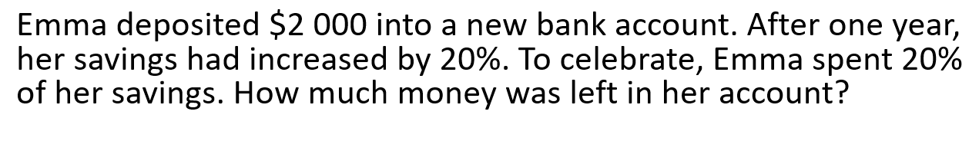
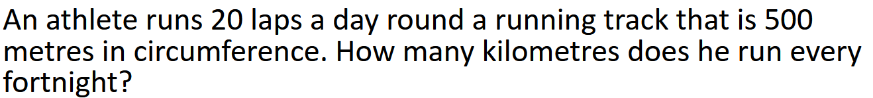
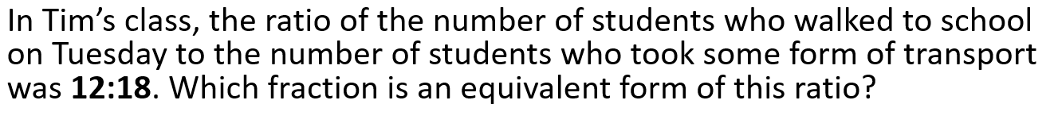
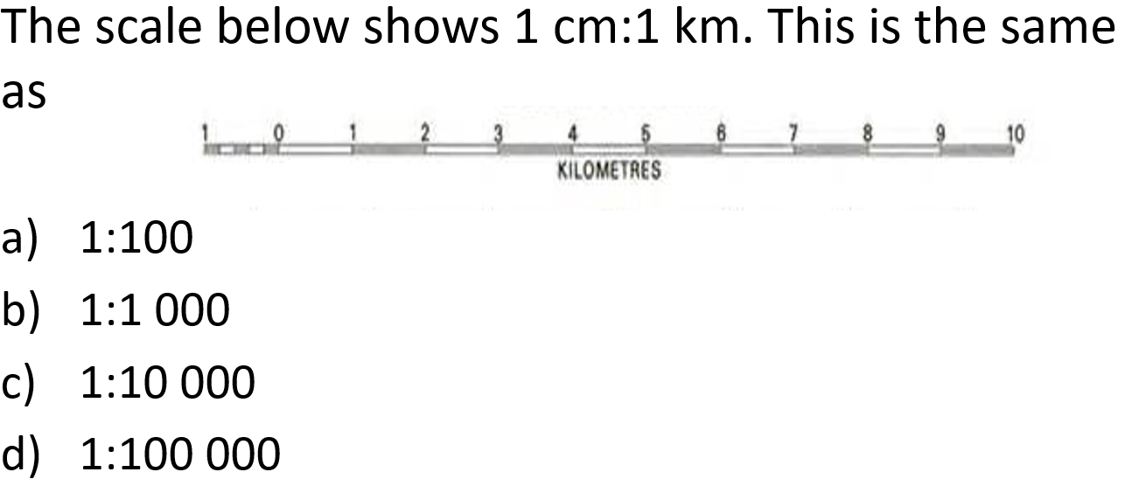
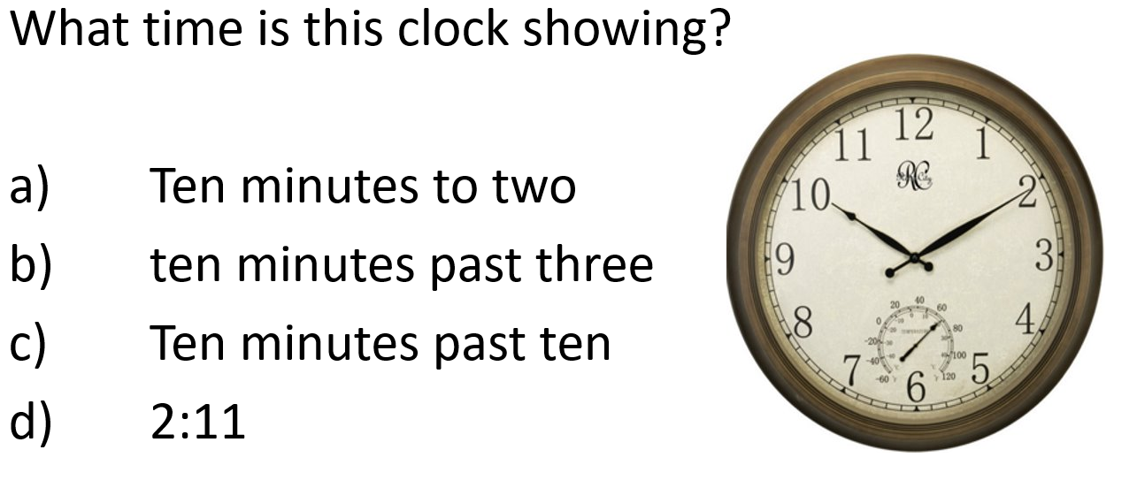
Topic: Application of Simple Interest EQ: How do we take borrowing money and apply it to interest and loans?

Slide 4

Answers:
1) $1920
2) 14 km
3) $\frac{2}{3}$
4) 1: 1000
5) Ten minutes pass 10

Slide 5

24
7
30
Topic: Application of Simple Interest
Date: /05/2021
EQ: How do we take borrowing money and apply it to interest and loans?
WICOR

Slide 6
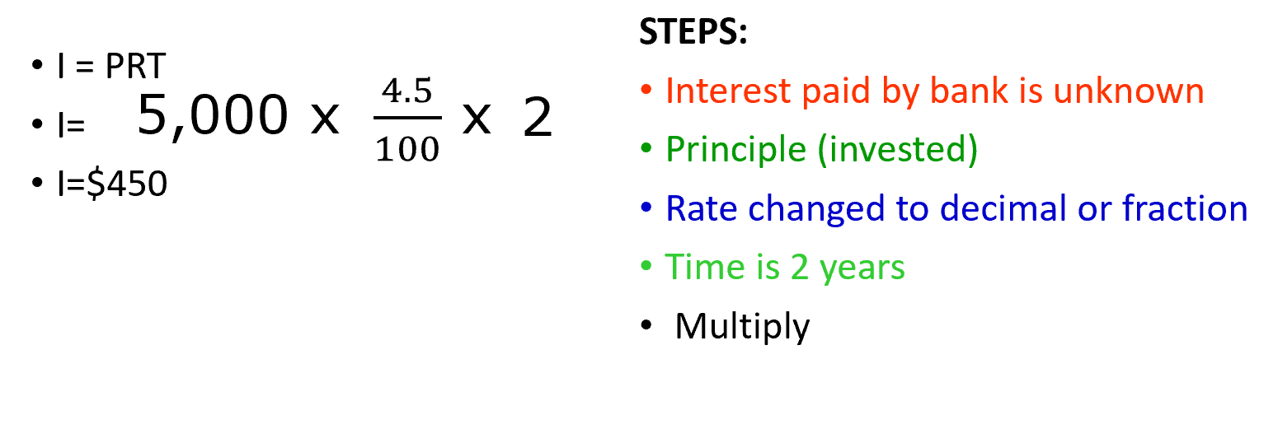
24
7
30
Topic: Simple Interest
EQ: How do we take borrowing money and apply it to interest and loans?
1. A savings account is set up so that the simple interest earned on the investment is moved into a separate account at the end of each year. If an investment of $5,000 is invested at 4.5%, what is the total simple interest accumulated in the checking account after 2 years.
Finding the Principal
WICOR

Slide 7
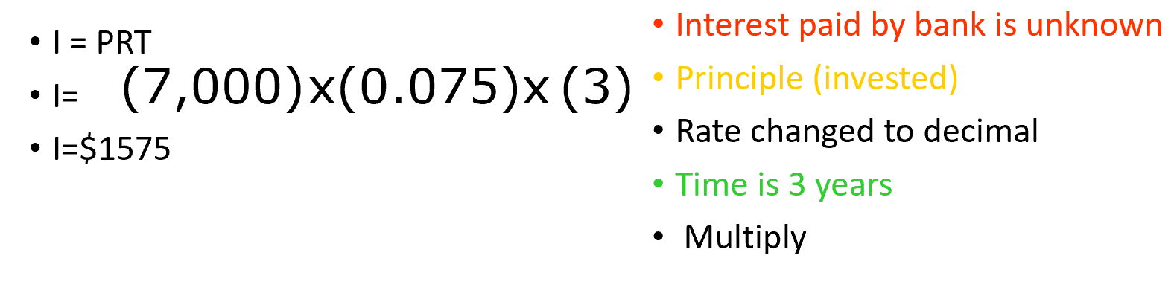
24
7
30
Topic: Simple Interest
EQ: How do we calculate the total amount by using Simple Interest?
2. A savings account is set up so that the simple interest earned on the investment is moved into a separate account at the end of each year. If an investment of $7,000 is invested at 7.5%, what is the total simple interest accumulated in the checking account after 3 years.
WICOR

Slide 8
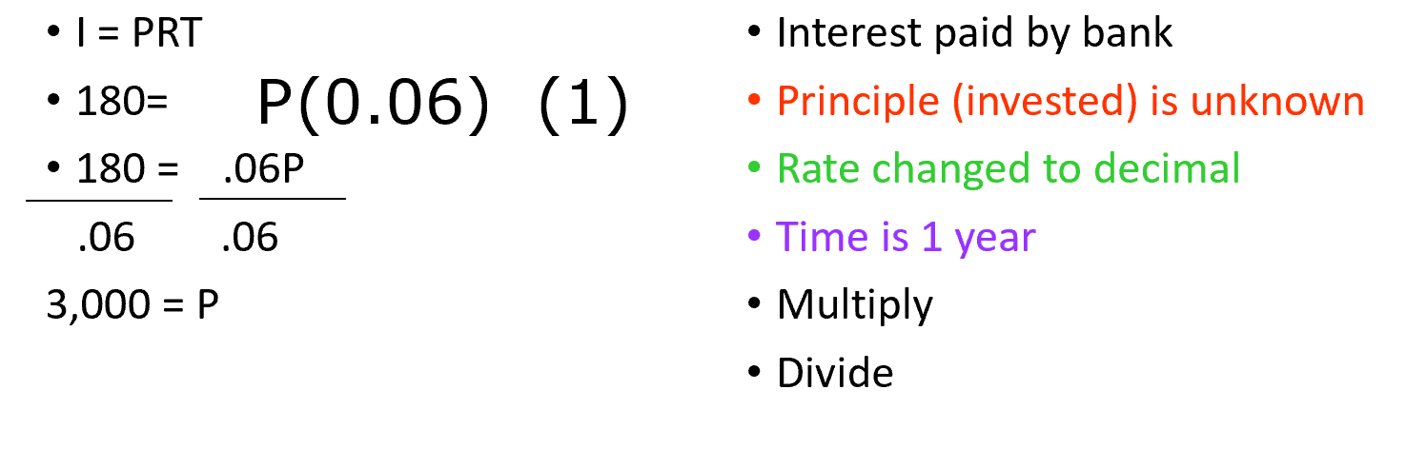
24
7
30
Topic: Simple Interest
EQ: How do we calculate the total amount by using Simple Interest?
3. When invested at an annual interest rate of 6% an account earned $180.00 of simple interest in one year. How much money was originally invested in account?
When the Principal is unknown
WICOR

Slide 9
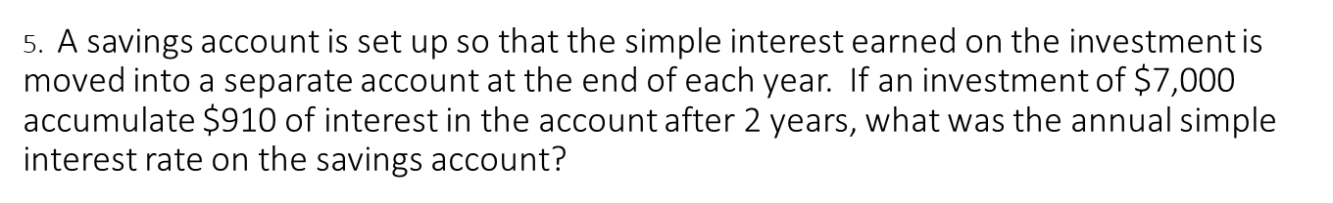
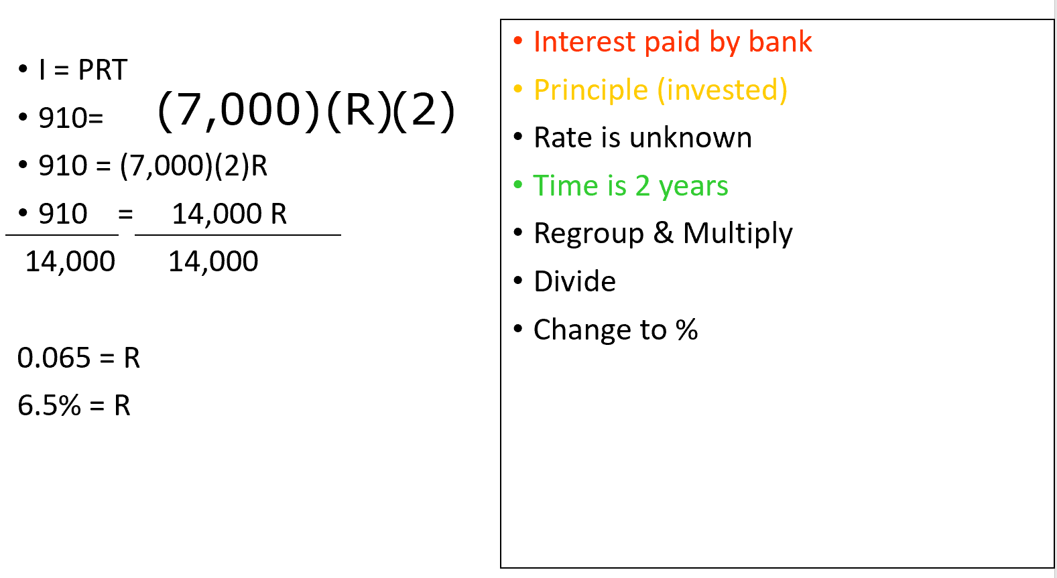
24
7
30
Topic: Simple Interest
EQ: How do we calculate the total amount by using Simple Interest?
How do I find the rate?
WICOR

Slide 10
Investigate (LHS)
Turn to page 55 of your Interleave Math Book and complete the questions

Slide 11

Thank you
Keep up the good work!
“The flower that blooms in adversity is the most rare and beautiful flower of all.”
-A.A Milne

